Slide 1
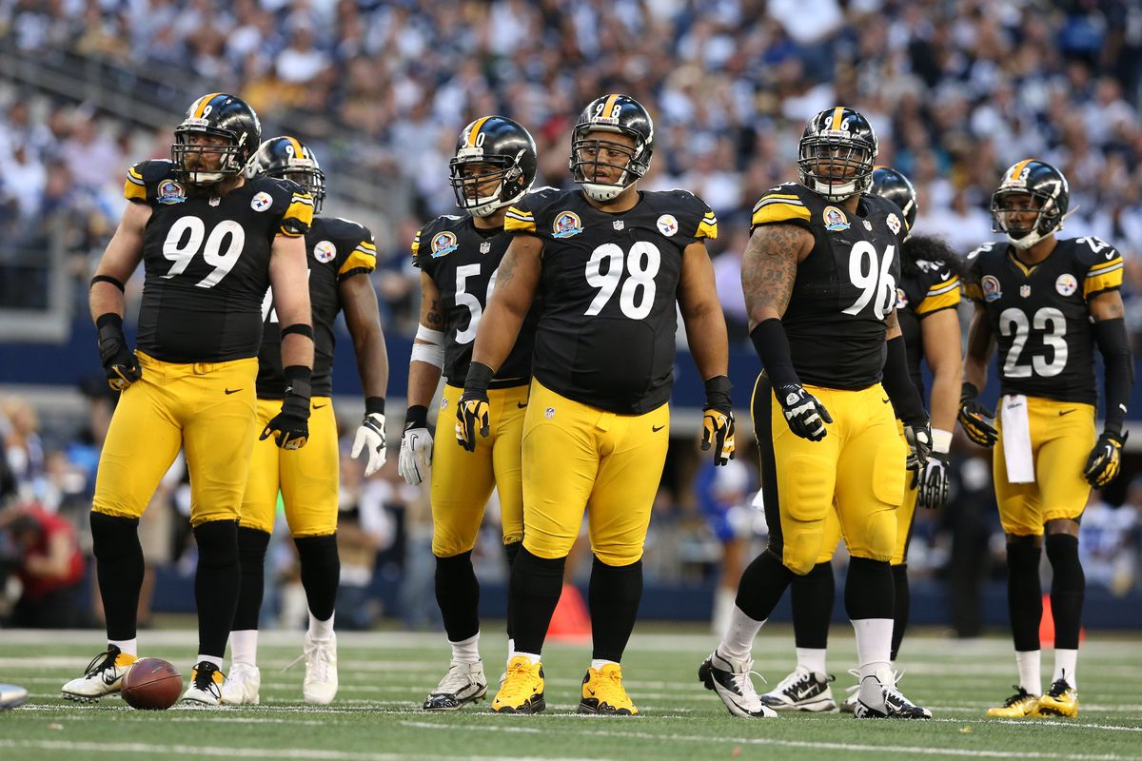
Evaluating the Defensive Line
Matthew Emmons-USA TODAY Sports
SIS Football Analytics Challenge
Scott Fields
scott.h.fields1@gmail.com

Slide 2
1. What is the most important D Line position?
I decided to look at this through the lens of techniques played on the field
What position someone is listed as doesn’t affect the game so let’s look at what people are actually doing on the field
In order to see how important a position is, we must see how it changes the total defensive performance when someone is playing it on the field
The simplest way to do this is by comparing the EPA per play when a position is filled and when it is empty

Slide 3
Ranking of On/Off EPA/Play Splits
(EPA on – EPA off)/(plays run from position)
Lower is better
4i Technique seems to be clear-cut winner on both sides of the line
When the 4i is being played on the right side, you can expect the offense to generate about .07 fewer points per play
Left side seems more important
Possibly due to higher quality O Linemen on the QB’s blindside
Inside the tackles seems more important
Likely due to the presence of OLBs rushing from outside the edge
TE
T
G
C
G
T
TE
9 6 7 5 4 4i 3 2 2i 1
0 1 2i 2 3 4i 4 5 7 6 9
0.0102
14th
0.0136
15th
0.0467
21st
-0.0032
10th
-0.0103
8th
0.0157
16th
-0.0308
5th
-0.0097
9th
0.0352
19th
-0.0229
6th
0.0254
17th
0.0058
13th
-0.0010
11th
-0.0126
7th
-0.0469
2nd
-0.0371
3rd
-0.0366
4th
0.0054
12th
-0.0697
1st
0.0284
18th
0.0428
20th

Slide 4
2. What is the nature of the distribution of talent between D Line positions?
Position | Standard Deviation | N*
R 4 | 0.368 | 34
R 4i | 0.367 | 58
L 2i | 0.347 | 51
L 4 | 0.323 | 36
L 7 | 0.322 | 51
R 5 | 0.314 | 63
R 2i | 0.312 | 67
0 | 0.305 | 70
L 9 | 0.300 | 80
R 7 | 0.300 | 55
R 9 | 0.299 | 70
R 6 | 0.277 | 34
L 4i | 0.268 | 69
L 5 | 0.267 | 55
R 3 | 0.257 | 139
R 1 | 0.253 | 89
L 6 | 0.252 | 43
L 1 | 0.250 | 84
L 3 | 0.246 | 135
R 2 | 0.229 | 23
L 2 | 0.221 | 23
I looked at the EPA per play of individual players playing individual positions on the D Line and looked at the standard deviation to judge the spread of talent at the position
A higher SD should indicate a wider spread between the best and the worst of those who regularly line up at any given position
There appears to be little pattern in terms of side of the field, but a significant portion of the lower SDs are from the interior
This indicates that it is less important to acquire high-quality players for the interior since replacement level players are likely to produce similar numbers
Conversely, techniques such as R 4 and L 4 may benefit more from high-end talent since they seem more likely to produce results further from average
* N = # of players that took 10+ snaps at that position

Slide 5
3. Situations that can change the most important D Line position
I am going to look at three factors that may influence which D Line technique/ position is most important: pass vs rush, the presence of outside linebackers, and the number of defensive linemen on a given play
For each of these situations I will compare the relative rankings of EPA on/off splits under the new circumstances vs how I answered Question 1 with no additional filters
For example, to look at EPA per play on/off splits for rushing plays, EPA per play “on” will be rushing plays where a given technique is filled, while EPA per play “off” will still be only rushing plays, where the given technique is not filled

Slide 6
Passing vs Rushing Plays
Passing plays position rankings stayed relatively stable compared to the original rankings in terms of EPA per play splits
Rushing plays showed no discernable pattern to how the position ranks changed, but they did change significantly
In addition, the Standard Deviation of EPA splits on passing plays was 0.053 while on rushing plays it was 0.034
The greater spread on passing plays indicates that the defensive front selected on passing downs matters to the expected outcome of the play much more than on rushing downs
This may also explain why the original rankings and the passing rankings match so closely; the passing plays are doing the bulk of determining which D Line positions are most important
Points above the diagonal indicate an improved rank on passing plays

Slide 7
The Presence of Outside Linebackers
If we look at plays with an OLB on only one side of the line, we see that most of the techniques that improve are on the opposite side of the OLB
This would make sense as the O Line is now likely dealing with additional pressure from the other side and may slide to accommodate
Interestingly, with the presence of a ROLB the technique rankings that worsen are also on the left side
The outcome of the presence of a LOLB is a bit more expected as most of the technique rankings that fall are on the same side as the OLB, but there is still a healthy amount of techniques on the right side that worsen as well

Slide 8
The Presence of Outside Linebackers
When comparing the changes associated with having two OLBs and no OLBs, the results are much more in line with common sense
In general, when we have OLBs on both sides, techniques inside the tackles benefitted while those outside the tackles worsened
Additionally, when there is no OLB support, techniques outside the tackles improved while interior positions fell off

Slide 9
The Effects of Different Numbers of D Linemen
The most notable potential pattern is that it may be beneficial to load up on the right side in a 4-man front, but it is not conclusive
There does not appear to be a large pattern in terms of interior vs exterior, and I have a feeling that this may be heavily influenced by the presence of OLBs also rushing on the play
The 2-man front changed the most from the original rankings, likely due to being run less than the 3 and 4-man, and perhaps more inherent volatility involved in having fewer D Linemen

Slide 10
Limitations and Future Analysis
One thing I think would be useful to expand this analysis, is being able to see what OLBs (and all players) are doing immediately after the snap, whether it be dropping into zone, covering a RB man-to-man, or anything else
This would especially benefit the “Presence of OLBs” section of my analysis because then I could filter beyond the “IsRushing” column provided which only helps in passing situations
Another beneficial piece of information would be seeing what formation the offense is running
Defenses aren’t run in a vacuum so the best defensive line analysis would probably be used to react to an offense’s personnel and be able to counter it with the optimal defensive front
In my future analysis, I would like to study how the different scenarios I mentioned in part 3 interact with each other, especially the number of D Linemen with the presence and positioning of OLBs

Slide 11
Conclusion
The most important D Line technique in a vacuum was the 4i just inside the Tackle
In general, the left side was more important likely due to weaker offensive linemen and scheme
In general, the interior was more important likely due to the presence of OLBs also rushing
While the interior seemed to be important to fill, it may not be as important to spend heavily at those positions as it seemed replacement level players were more likely to produce similarly to top of the line players
Passing plays appeared to drive the importance of D Line positions more than rushing plays
The interior of the line became more important when the exterior was filled by OLBs and similarly, the exterior became more important with no OLBs

